Slide 1



Energy Consumption Patterns in Boston using Big Data Analytics
Hritvik Mahajan
28 June 2023

Slide 2


Introduction
Understanding Energy Consumption Patterns in Boston using Big Data Analytics.
Problem statement: Analyzing energy consumption patterns in Boston to identify factors impacting energy usage and inform sustainable energy management.
The problem at hand is to analyze energy consumption patterns in Boston to determine if there are any significant factors that impact energy usage, such as time of day, seasonality, weather conditions, or specific events.
By identifying these factors, we can develop strategies to optimize energy consumption, reduce waste, and promote energy conservation initiatives.

Slide 3
DATASET selection
A dataset titled "City of Boston Utility Data" is available on the official data portal of the City of Boston. This dataset, provided in CSV format, contains information related to utility usage and consumption within the city.
Utility datasets are valuable for a range of applications, including analyzing consumption patterns, identifying trends, promoting energy efficiency, and implementing conservation measures. They can also assist in infrastructure planning, billing, and resource allocation.
The dataset consists of 25 features with 638,657 records.
The file includes the following columns: State, Energy Type, Department Name, Date, Supply Cost, Total Cost, Delivery Cost, Total, Consumption, Usage Period, Invoice, and Account Number.

Slide 4

Data Cleaning and EDa
Data Retrieval and Inspection:
API request to retrieve data from Boston government's data portal.
JSON response converted into a pandas DataFrame.
Data Preprocessing:
Reading data from "mydata.csv" and creating a DataFrame.
Renaming columns for clarity and consistency.
Missing value imputation for relevant columns.
Dropping unnecessary columns.
Imputing missing values in "Total_Consumption" column.
Converting date columns to datetime format.
Obtaining basic dataset information and summary statistics.
Data Analysis and Visualization:
Calculating average total consumption and demand over the years.
Creating a histogram to visualize energy type occurrences.

Slide 5
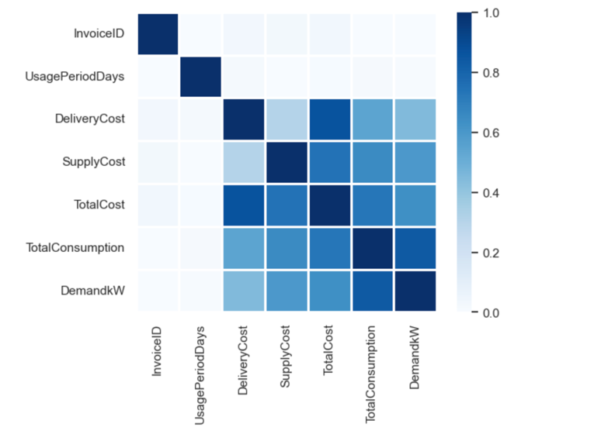
Heatmap
A strong positive correlation can be observed between the variables of delivery cost, supply cost, total cost, and total consumption.
Based on the strong positive correlation observed, the features of delivery cost, supply cost, and total cost have been selected to predict total consumption.

Slide 6
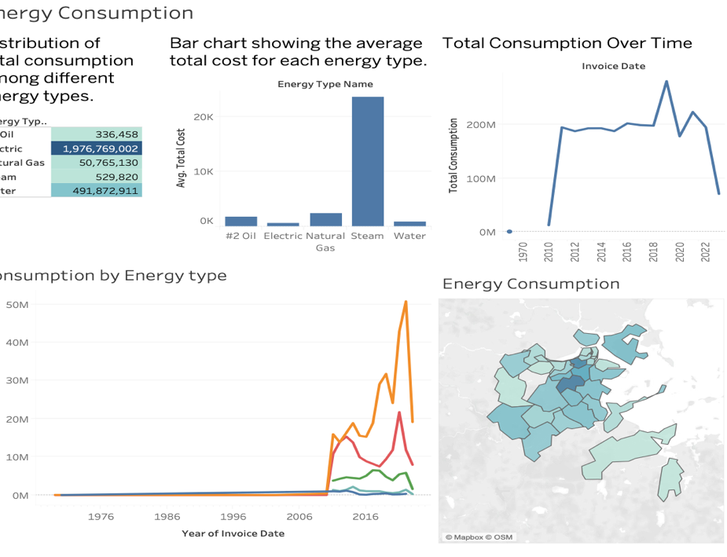
VISUALIZATION-Dashboard 1
The first highlight table compares energy consumption across different types, showing electricity as the highest.
The second bar chart reveals steam as the most expensive and electricity as the least expensive energy type.
The third line graph indicates a peak in energy consumption during 2018-2020.
The fourth discrete line graph emphasizes electricity's dominance in consumption among different types.
The fifth symbol map visually displays energy consumption across areas of Boston, highlighting distribution patterns.

Slide 7
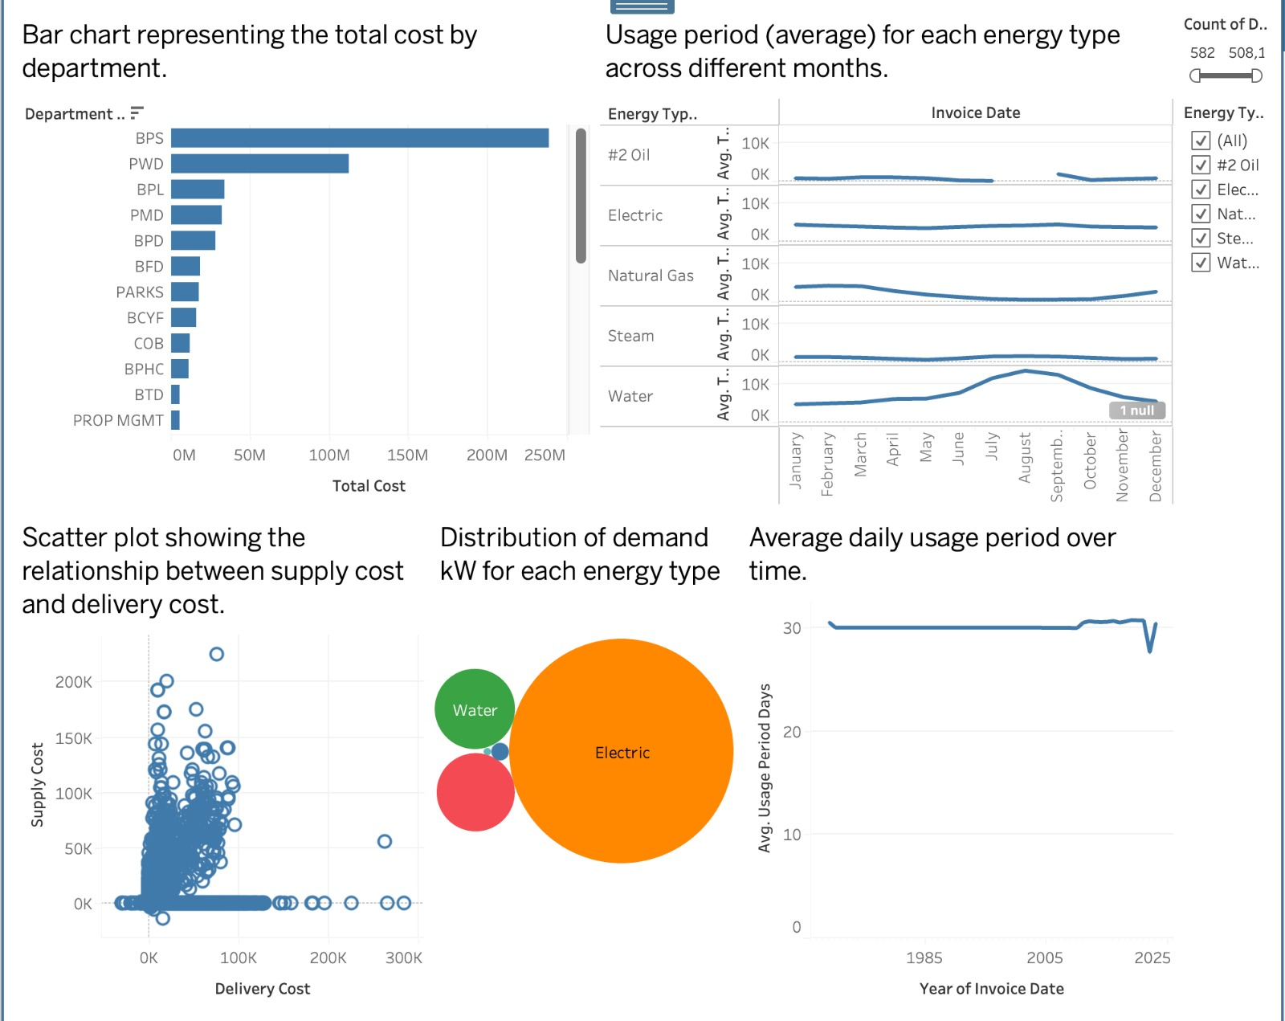
VISUALIZATION-Dashboard 2
The first graph indicates that the BPS department has the highest energy expenses among different departments.
The second graph shows seasonal variations in energy usage, with an increase in water consumption starting in June and a decline in natural gas usage during the same period.
The third graph presents the relationship between the supply cost and delivery cost of energy.
The fourth graph highlights the strong demand for electricity, which is the most utilized energy source.
Lastly, the fifth graph depicts a consistent average energy usage of around 30, with a slight decrease observed between 2021 and 2022.

Slide 8
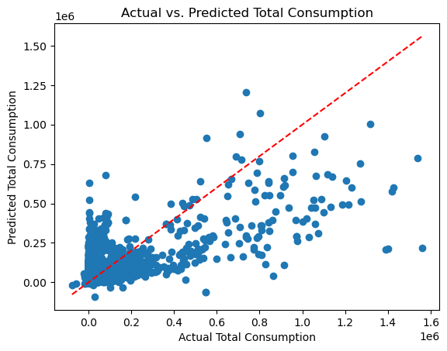

ANALYSIS-LINEAR Regression Model
The model has a relatively large mean squared error, indicating a significant level of prediction error.
The model explains approximately 55.25% of the variance in the dependent variable, suggesting a moderate level of explanatory power.

Slide 9
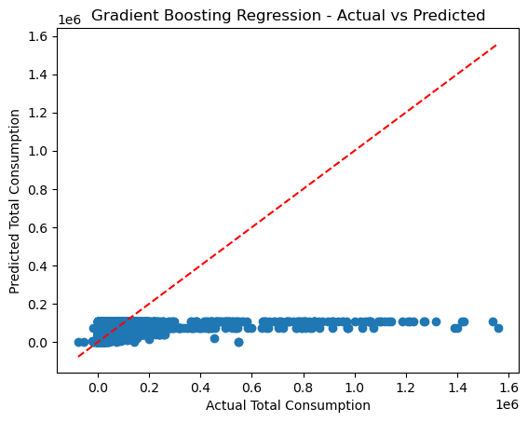

ANALYSIS-GRADIENT BOOST Regression Model
The high MSE indicates that the model's predictions have a significant amount of error or deviation from the actual values.
The R-squared value of 0.22122173273343526 suggests that the independent variables used in the model explain only about 22.12% of the variance in the dependent variable.

Slide 10
Results of the analysis
Electricity emerges as the most widely used and cost-effective energy type, based on the first highlight table and the second graph in Dashboard 1.
The period between 2018 and 2020 witnessed a peak in total energy consumption, as depicted in the line graph in Dashboard 1. This observation implies a notable surge in energy usage during that time frame, suggesting the importance of analyzing factors contributing to this increase. The symbol map in Dashboard 1 reveals diverse energy consumption patterns across various areas of Boston.
The linear regression model outperformed the gradient boost model in terms of mean squared error, suggesting that it has better predictive accuracy. Additionally, the linear regression model achieved an R-squared value of 0.5526, indicating that it can explain approximately 55.26% of the variance in the data.
The gradient boost model had a lower R-squared value of 0.2212, suggesting that it explains only around 22.12% of the variance.

Slide 11
Conclusion $ RECCOMENDATION
The linear regression model achieved a lower mean squared error (MSE) compared to the gradient boost model. This indicates that the linear regression model provides more accurate predictions overall.
In terms of the R-squared value, the linear regression model outperforms the gradient boost model. The linear regression model explains a larger portion of the variance in the data, indicating a better overall fit.
The linear regression model remains a suitable choice when the relationship between the predictors and the total consumption variable is expected to be linear or can be adequately approximated by a linear relationship.

Slide 12


Thank You!

